Slide 1
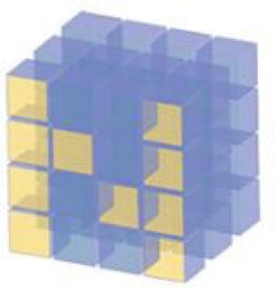
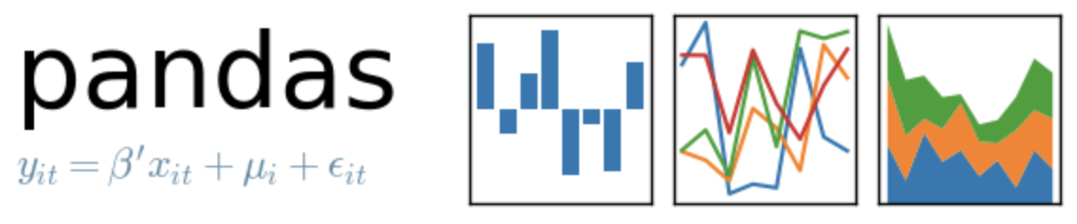
Numpy Array
Pandas
DataFrame
vs

Slide 2
Reference
Youtube
Code

Slide 3
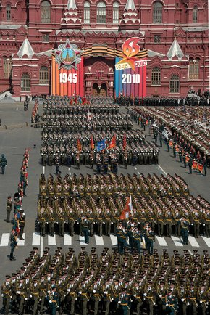
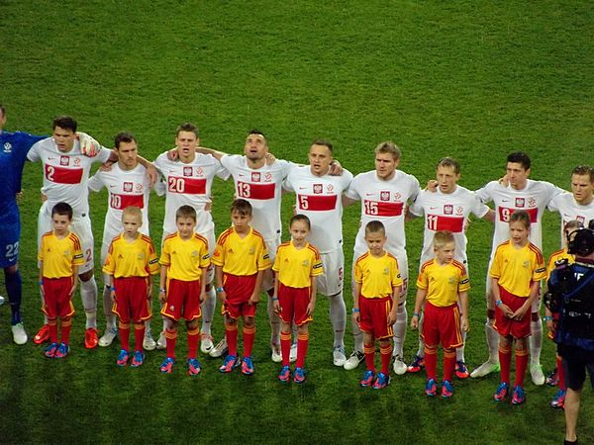
Numpy Array
Pandas
DataFrame
vs

Slide 4
Numpy Array
Pandas
DataFrame
vs

Slide 5
Numpy Array
Pandas
DataFrame
vs
different dtype

Slide 6
Numpy Array
Pandas
DataFrame
vs
different dtype
same dtype

Slide 7
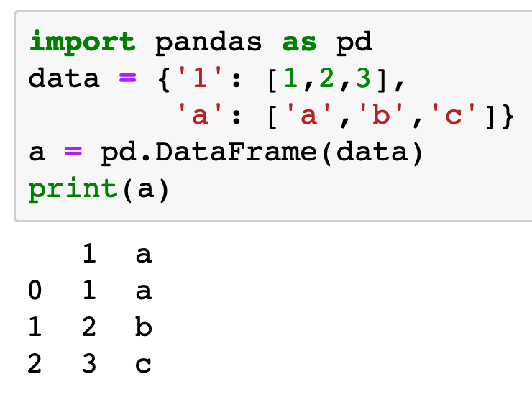
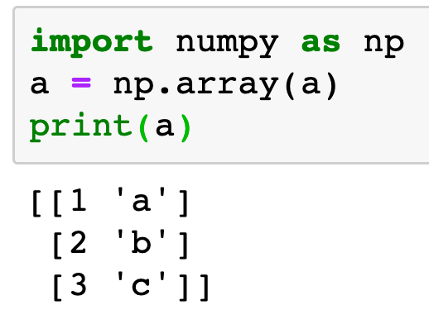
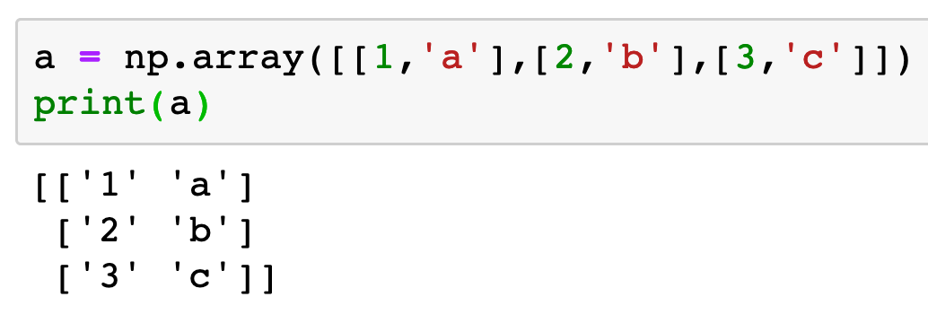
Numpy Array
Pandas
DataFrame
vs
different dtype
same dtype

Slide 8
Numpy Array
Pandas
DataFrame
vs
int
different dtype
same dtype

Slide 9
Numpy Array
Pandas
DataFrame
vs
int
str
different dtype
same dtype

Slide 10
Numpy Array
Pandas
DataFrame
vs
int
str
str
different dtype
same dtype

Slide 11
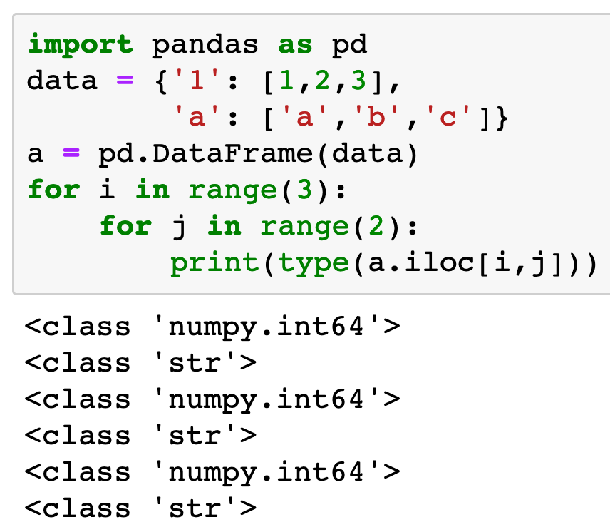
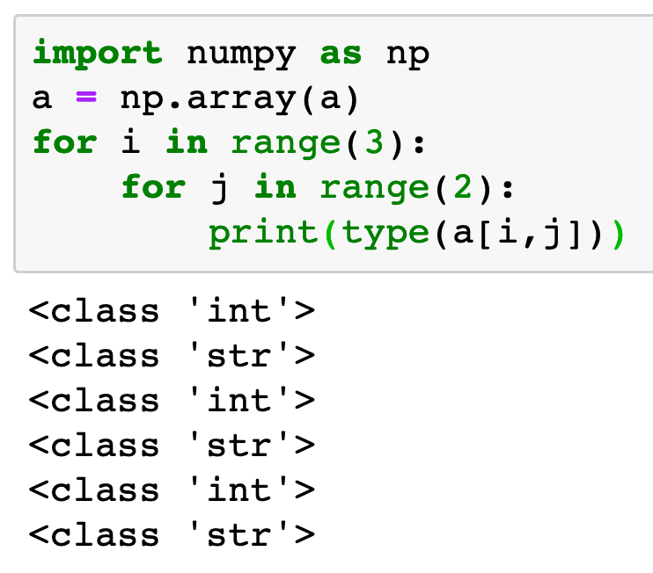
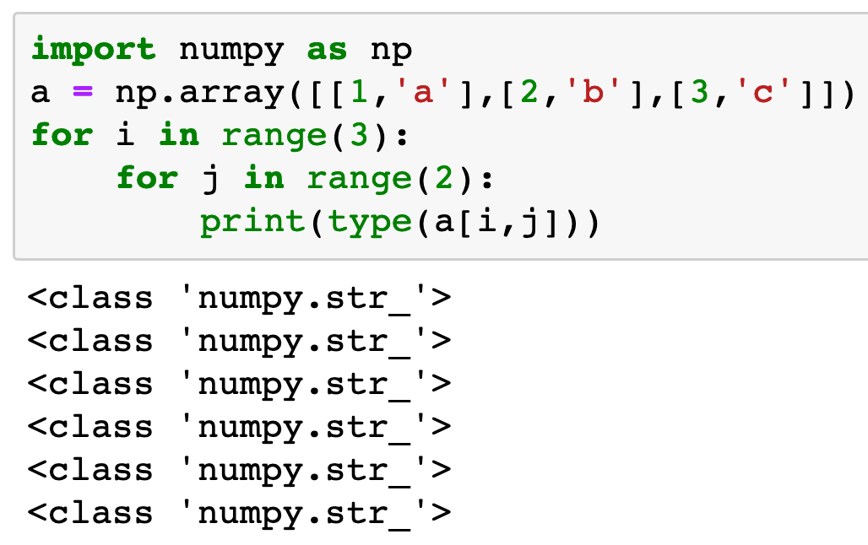
Numpy Array
Pandas
DataFrame
vs
different dtype
same dtype

Slide 12
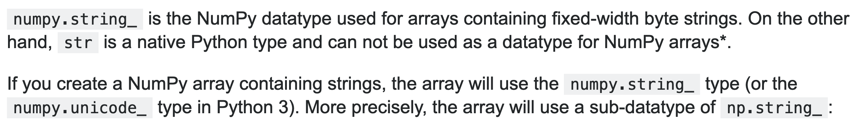
stackoverflow

Slide 13
Now
Let’s Play with Code

